Slide 1
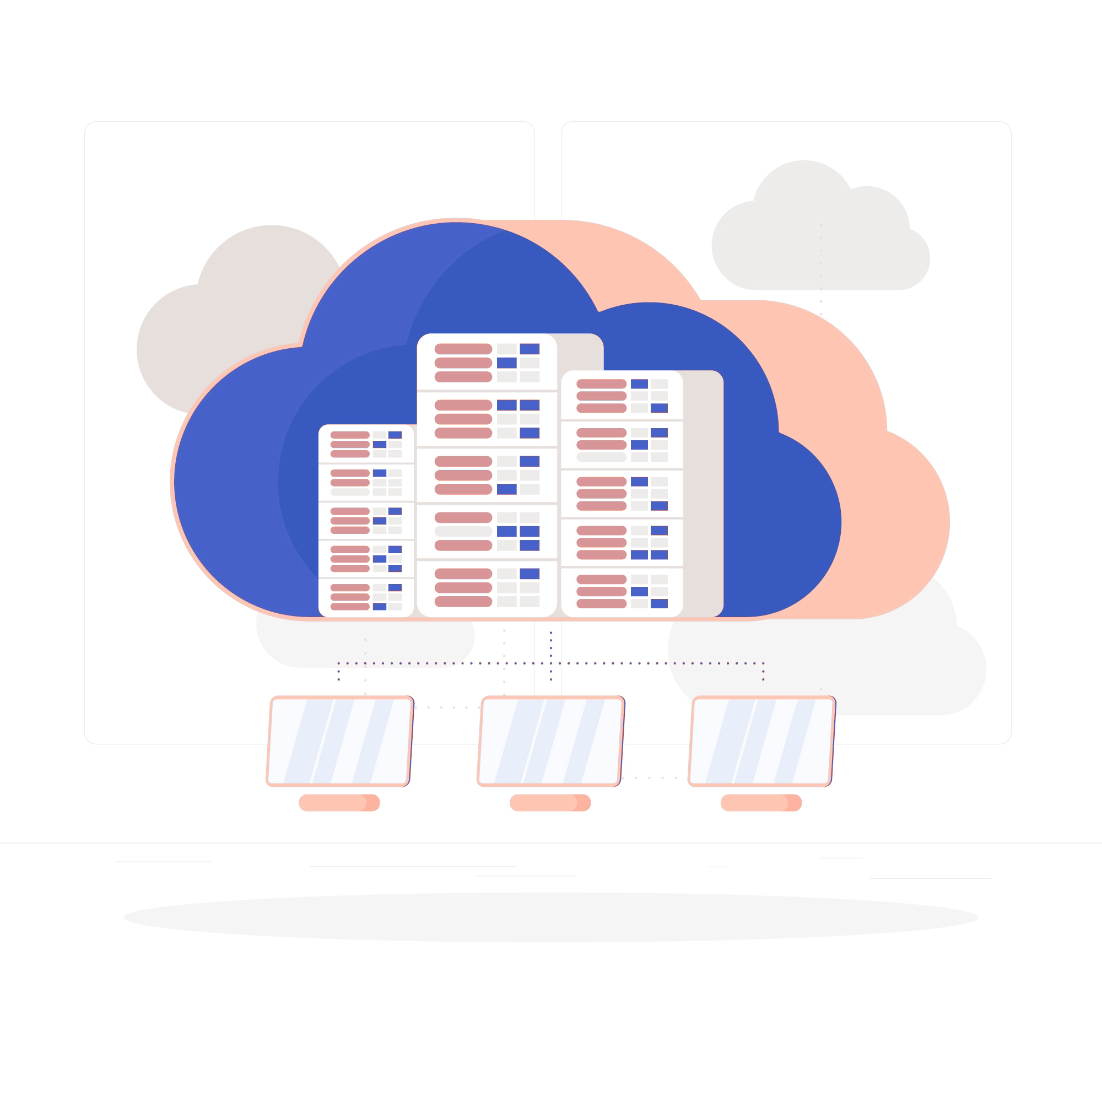
Introduction to cloud computing

Slide 2

Overview _ what we will cover ?
Demystifying the Web : Unlock the secrets behind website functionality and user interaction.
Virtualization concept : Explore the world of virtual machines and resource optimization.
Historical Insights & IT Challenges : Identify challenges and limitations of traditional IT approaches
Cloud Computing Decoded : Defining cloud computing, exploring its key characteristics, types, and the pricing dynamics that shape the cloud landscape
Shared Responsibility & Security : Learn about AWS’s approach to cloud security and compliance
AWS Global Insight : Explore AWS’s extensive global network and infrastructure
Notes:
Welcome to an immersive journey through the realms of web technology, virtualization, and the revolutionary cloud computing
We have a packed agenda ahead, designed to provide you with a holistic understanding of these interconnected domains
"Prepare to immerse yourself in a comprehensive exploration, designed to empower you with knowledge and skills for the digital future
Demystifying Websites:
"Kickstarting our journey with a deep dive into the mechanics of websites, unraveling how they function and connect us in the digital space."
Virtualization Unleashed:
"Exploring the magic behind virtualization, its types, and the tangible benefits virtual machines bring to the table."
Historical Insights & Challenges:
"Stepping back in time to the Dot-com Boom, understanding the growing complexities in IT, and dissecting the problems with traditional IT approaches."
Cloud Computing Decoded:
"Defining cloud computing, exploring its key characteristics, types, and the pricing dynamics that shape the cloud landscape."
Shared Responsibilities & AWS Insights:
"Diving into the shared responsibility model, deciphering Amazon’s pioneering role in cloud computing, and exploring AWS’s global infrastructure."
Navigating AWS & Cloud Best Practices:
"Guiding you through choosing the right AWS region, understanding edge locations, and adopting AWS Well-Architected Pillars for optimal cloud usage."
*****************************************************************
Web Wisdom:
"Master the fundamentals of how websites work, gaining insights into the digital threads that weave the World Wide Web."
Virtualization Virtuosity:
"Develop a deep understanding of virtualization, its various forms, and the transformative benefits of virtual machines."
Historical Context and IT Evolution:
"Acquire a historical perspective with the Dot-com Boom, understand the complexities of traditional IT, and identify the pitfalls of past practices."
Cloud Computing Mastery:
"Demystify cloud computing, delve into its key characteristics, types, and pricing models, transforming the way you perceive and interact with the cloud."
Shared Responsibility and AWS Expertise:
"Grasp the concept of shared responsibility in cloud security and gain exclusive insights into Amazon’s journey and leadership in cloud services."
Navigating AWS and Architecting Excellence:
"Learn how to strategically select AWS regions, understand the significance of edge locations, and adopt best practices with AWS Well-Architected Pillars."

Slide 3
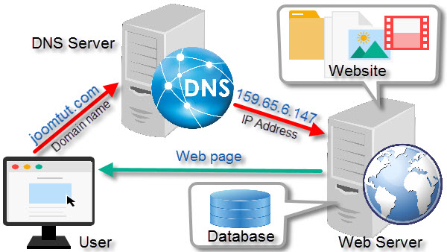
How websites work ?
Notes:
In 1989, Sir Tim Berners-Lee's invention of the World Wide Web (WWW) marked a pivotal moment in internet history. It introduced a user-friendly interface and standardized protocols that made the internet accessible to the general public. As the 1990s dawned, we witnessed the rapid rise of internet service providers (ISPs) and the emergence of the first web browsers, such as Netscape Navigator and Internet Explorer. These browsers, combined with the availability of ISPs, made accessing the web more convenient than ever before. But how do websites actually work? At their core, websites are collections of files stored on web servers. When you enter a web address into your browser, it sends a request to the server hosting the corresponding website. The server processes this request and sends back the web page's files, which your browser then interprets and displays as the familiar webpage. This dynamic interaction between browsers and web servers is the essence of how websites function, enabling us to access information, services, and entertainment from anywhere with an internet connection
The Humble Beginnings laid the foundation for the explosive growth and innovation that would follow in the Dot-com Boom.

Slide 4
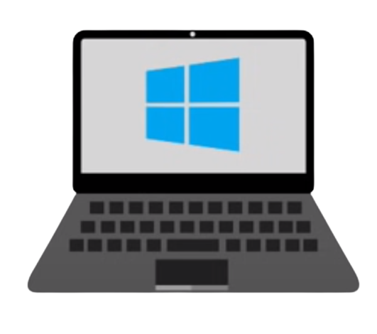
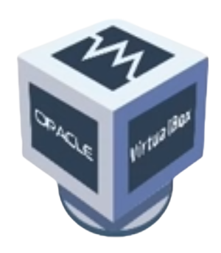
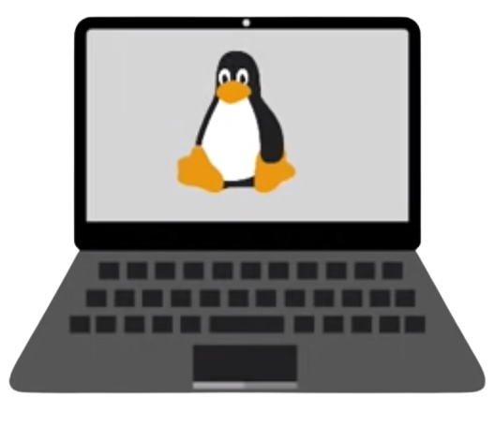


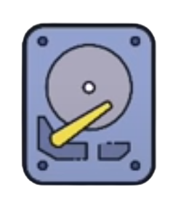
Virtualization
Linux OS
4 GB
Applications
windows OS
With virtualization
Hypervisor
Host OS
No separate hardware needed
4 GB
Hardware
Separate hardware
Hardware
Total 8GB
VirtualBox takes hardware resources from host OS
VirtualBox creates virtual CPU , RAM , storage for each VM
You can only give resources you actually have
Notes:
lets discuss the concept of virtualization, a powerful technology that has revolutionized the way we utilize hardware resources in computing.
Virtualization is the technology that allows you to create multiple simulated environments or dedicated resources from a single, physical hardware system.
Before Virtualization:
In the traditional computing model, each operating system required its own physical hardware.
This approach was straightforward but came with significant limitations. For instance, if an application was designed to run on a different operating system, the only solution was to invest in new, separate hardware.
This resulted in underutilized resources, increased costs, and a complex management overhead.
The Advent of Virtualization:
Virtualization emerged as a game-changing solution to these challenges.
It allows multiple operating systems to share the same hardware resources, running independently in isolated virtual environments.
This is made possible by a layer called the hypervisor, which sits between the hardware and the operating systems, allocating resources as needed.
Benefits and Use Cases:
This innovation brings forth a plethora of benefits.
It maximizes hardware utilization, reduces costs, simplifies management, and enhances the flexibility and scalability of our computing environments.
For developers and businesses, this means being able to run multiple applications on different operating systems, all on the same physical machine.
Resource Allocation:
With virtualization, we are no longer bound by the limitations of physical hardware.
Resources like CPU, RAM, and storage can be dynamically allocated and adjusted based on demand, ensuring optimal performance and efficiency.

Slide 5
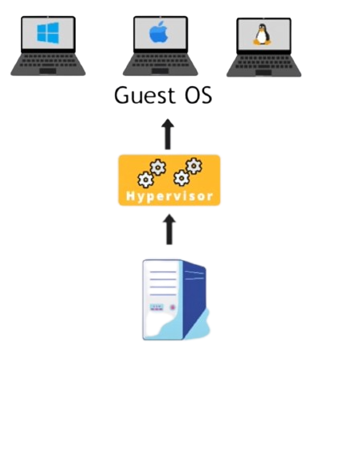
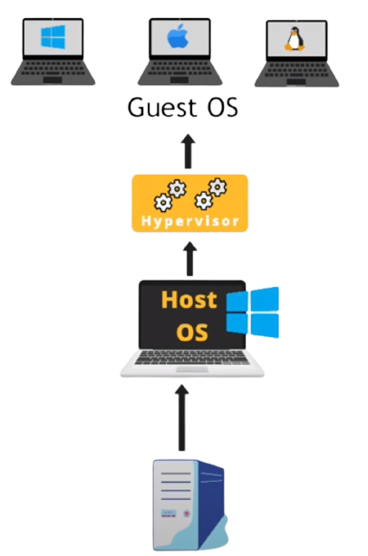
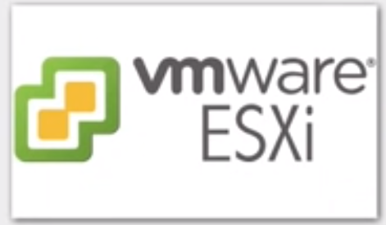
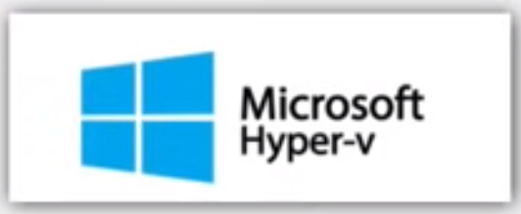
Types of Virtualization
Type 1
Type 2
On bare metal
For big companies
Personal computers
Notes:
"As we've seen, virtualization marks a significant shift in how we utilize hardware resources, allowing for multiple operating systems to run on a single physical machine. This brings us to our next crucial topic—understanding the different types of virtualization available today”
Type 1 virtualization runs directly on the hardware, without the need for a host operating system. The hypervisor sits directly on top of the physical hardware, interacting with it directly.
Examples: VMware vSphere/ESXi, Microsoft Hyper-V for Server, and Xen.
Use Cases: This setup is optimal for environments that demand high performance, efficiency, and scalability—traits essential in enterprise settings and data centers.
Benefits: It offers higher performance, better resource utilization, and stronger isolation between virtual machines, leading to increased security and stability.
Type 2: Hosted Virtualization:
Definition: Type 2 virtualization, on the other hand, runs on a conventional operating system with a hypervisor installed as a software layer.
Examples: VMware Workstation, Oracle VirtualBox, and Parallels.
Use Cases: This approach is well-suited for development, testing, and educational purposes, where the ease of setup and flexibility are more crucial than squeezing out every bit of performance.
Benefits: It is user-friendly, easy to set up, and provides a flexible environment for users to run multiple operating systems on their personal computers.

Slide 6
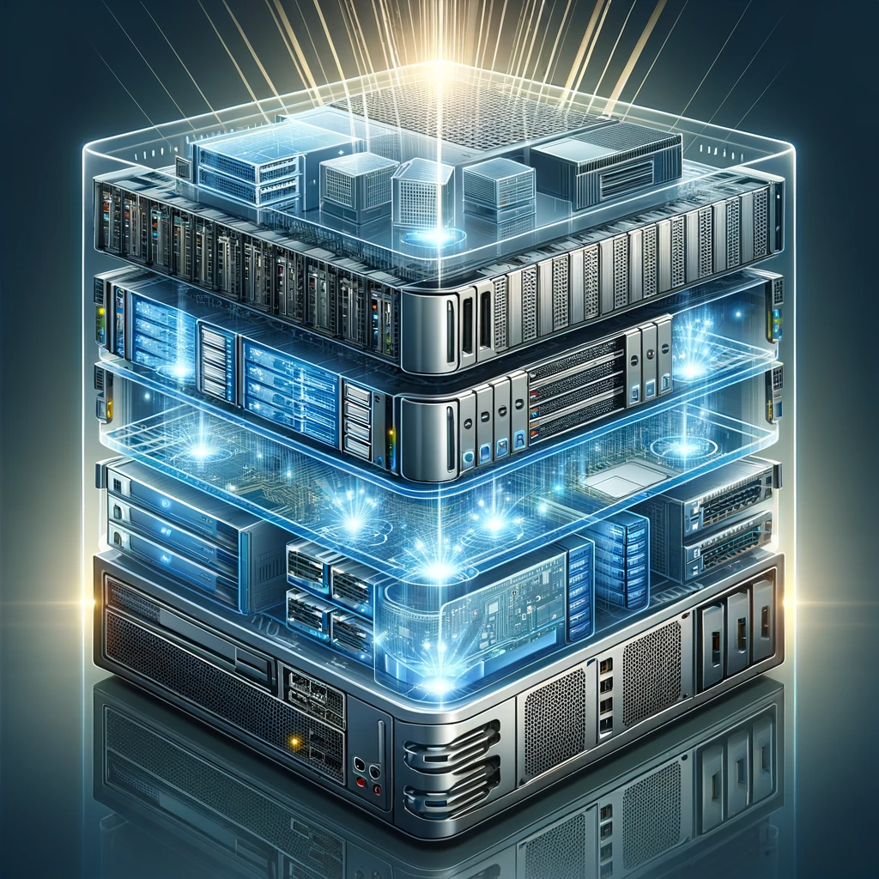
Benefits of Virtual machines
Software Development and Testing
Training and Labs
Legacy Software Maintenance
Efficient usage of hardware resources
VM are completely separated
flexibility of choosing any resource combination
Abstraction of the operating system from the hardware ( OS loosely coupled to the hardware )
Os as a portable file system
Backup and Disaster Recovery
Notes:
Software Development and Testing: Virtual Machines provide an isolated environment, allowing developers and testers to work without the risk of harming the main system. Any errors or bugs remain confined, ensuring the integrity of the main environment.
Training and Labs: For those in the educational sector or corporate training environments, VMs offer a safe sandbox for hands-on experience without any permanent consequences.
Legacy Software Maintenance: Some of our older, yet crucial applications might not run on modern systems. VMs allow us to emulate older environments, ensuring that legacy software continues to function seamlessly.
Efficient Usage of Hardware Resources: Instead of letting hardware resources go to waste, VMs allow multiple operating systems to share a single physical server, maximizing efficiency.
Complete Separation: Each VM operates independently. This means a malfunction in one VM doesn't affect the others, ensuring stability.
Flexibility in Resource Allocation: With VMs, you can choose the perfect combination of storage, memory, and processing power based on individual requirements.
Abstraction of the Operating System: One of the most pivotal benefits is the loose coupling of the OS from the hardware. This abstraction means that the OS isn't directly tied to any specific hardware, offering greater flexibility.
OS as a Portable File System: Think of the OS in a VM as a file. This portability means you can move, copy, or replicate it across systems effortlessly.
Backup and Disaster Recovery: In the unfortunate event of a system failure, VMs can be a lifesaver. The portability ensures quick recovery, minimizing downtime.
In essence, virtualization has opened up new horizons in how we approach computing, offering unparalleled levels of efficiency and flexibility.
It stands as a testament to the innovative spirit of the tech community, constantly pushing boundaries and finding smarter ways to leverage our resources.

Slide 7

The Growing Complexity of Traditional IT
On-premises setups demanded constant attention. From software updates and security patches to hardware repairs and replacements, businesses had to be perpetually vigilant.
Notes:
The image before you captures the essence of what many businesses were grappling with.
Before the cloud, companies and organizations hosted and maintained hardware such as compute, storage, and networking equipment in their own data centers. They often allocated entire infrastructure departments to take care of their data centers, which resulted in costly operations that made some workloads and experimentation impossible. This vast server room, with its tangled cables, overloaded racks, and warning lights flashing in urgency, paints a vivid picture of the challenges of traditional on-premises infrastructure.
Every cable and server rack here represents not just technology but constant maintenance demands. Picture a team working around the clock, addressing software updates, hardware failures, and security threats. And for every red light blinking, imagine the hidden costs — electricity, cooling, real estate, and skilled staff to manage it all. This tangled web of infrastructure was a clear signal: for large-scale companies aiming for global reach and rapid innovation, the traditional on-premises approach was no longer tenable.

Slide 8

Problems with traditional IT approach
Pay for the rent for the data center
Pay for power supply, cooling, maintenance
Adding and replacing hardware takes time
Scaling is limited
Hire 24/7 team to monitor the infrastructure
How to deal with disasters? (earthquake, power shutdown, fire…)
Notes:
In the realm of traditional IT, we face a myriad of challenges that hinder efficiency and flexibility. First, we're accustomed to paying for data center rental, along with the costs of power supply, cooling, and maintenance—a considerable financial burden. Adding or replacing hardware is a time-consuming process, limiting our scalability. Furthermore, the need to hire a 24/7 team for infrastructure monitoring can strain resources. Moreover, the looming question of how to cope with disasters such as earthquakes, power shutdowns, or fires adds a layer of uncertainty and complexity. These issues underscore the limitations of the traditional IT approach, prompting many organizations to seek more agile and cost-effective alternatives like cloud computing.

Slide 9
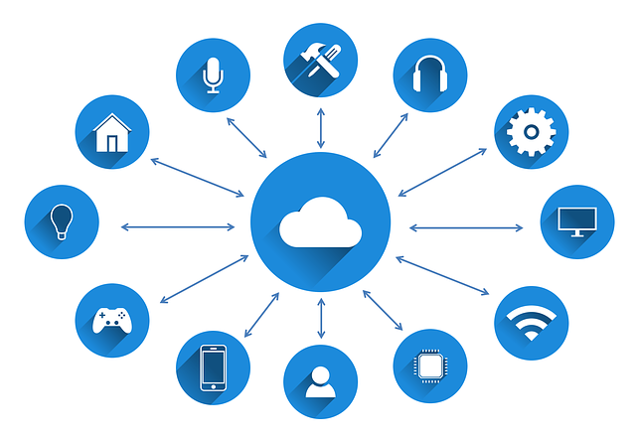
What is Cloud Computing?
Cloud computing is the on-demand delivery of compute power, database storage, applications, and other IT resources
You can provision exactly the right type and size of computing resources you need
You can access as many resources as you need, almost instantly
With data redundancy and disaster recovery features, cloud providers ensure high availability, minimizing potential downtimes.
Notes:
As we navigated through the complexities and challenges of traditional IT, the industry was ripe for a revolution. This is where cloud computing comes into play, offering a new paradigm that addresses the shortcomings of the past and paves the way for a more efficient, scalable, and flexible future
At its core, cloud computing is about empowerment and flexibility. Imagine a world where powerful IT resources — be it storage, processing power, or even sophisticated applications — are at your fingertips, ready to be summoned whenever you need them. No more waiting, no more cumbersome installations.
But the beauty of the cloud lies not just in its availability, but in its adaptability. Think of it as a tailor-made suit. In the cloud, you're not confined to one-size-fits-all solutions. Instead, you can tailor your resources to fit your exact needs. Need a small, nimble server for a lightweight application? It's yours. Require a powerhouse for data-intensive tasks? The cloud has you covered.
In short Cloud computing means being able to use IT resources without owning them.

Slide 10

Why the Name "Cloud"?
The term 'cloud' in cloud computing captures the essence of abstraction. It symbolizes moving from physical, on-premises servers, represented by the grounded server in our illustration, to the intangible, scalable, and omnipresent nature of the internet, depicted by the ethereal clouds.
Notes:
Let's take a moment to ponder the image before us. What you see is more than just a visual representation; it's the very essence of why we term it 'cloud computing'
Rather than being confined to physical hardware, our data and applications reside in the 'cloud', an abstract space, scalable and accessible from anywhere. This image perfectly encapsulates the evolution from rigid, location-bound infrastructure to the fluid, boundary-less realm of the cloud."

Slide 11

Virtualization in Cloud Computing
Server Virtualization: "Creating virtual servers to optimize hardware usage."
Storage Virtualization: "Pooling physical storage from multiple devices into a single virtual storage device."
Network Virtualization: "Combining hardware and software network resources and managing them as a single entity."
Application Virtualization: "Running applications from a remote server rather than on the user’s computer."
Notes:
Understanding cloud computing’s fundamentals brings us to a critical component that powers this technology—virtualization.
as we saw earlier : Virtualization allows multiple virtual instances on a single physical machine. In cloud computing, this concept is elevated to deliver services over the internet
Virtualization is the heart of cloud computing, enabling the efficiency, scalability, and flexibility that defines cloud services.
The Role of Virtualization in Cloud Computing
Resource Optimization: "Virtualization optimizes physical hardware resources, ensuring they are utilized to their fullest potential."
Flexibility and Scalability: "It provides unparalleled flexibility, allowing for quick scaling up or down based on demand."
Differences Between Virtualization and Cloud Computing
Virtualization: "Focuses on maximizing physical hardware use. It can exist without cloud computing."
Cloud Computing: "A broader concept that delivers computing as a service. While it relies on virtualization, it also includes additional features like self-service, broad network access, and automated management."
Types of Virtualization in Cloud Computing
Server Virtualization: "Creating virtual servers to optimize hardware usage."
Storage Virtualization: "Pooling physical storage from multiple devices into a single virtual storage device."
Network Virtualization: "Combining hardware and software network resources and managing them as a single entity."
Application Virtualization: "Running applications from a remote server rather than on the user’s computer."
In essence, virtualization is integral to cloud computing, providing the technical foundation needed to deliver cloud services efficiently and effectively.

Slide 12
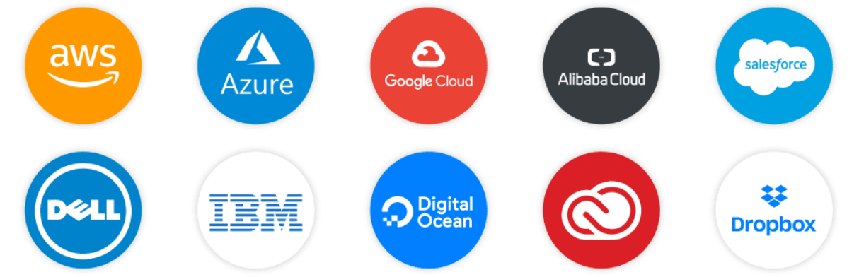
Leading Cloud Providers
Notes:
it's evident that the cloud landscape is both vast and diverse. These top 10 providers, each with its unique strengths, collectively define the cloud computing ecosystem.
From AWS's pioneering infrastructure to Microsoft Azure's enterprise integrations, and from Google Cloud's data analytics prowess to the specialized services of Oracle, Alibaba, Salesforce , DELL , IBM , digitalocean , adobe and dropbox — the choices in cloud platforms are abundant.
( Starting with AWS, the trailblazer, known for its robust infrastructure and wide array of services. Then there's Microsoft Azure, seamlessly integrating with enterprise solutions and boasting a global network. Google Cloud stands out with its advanced data analytics and machine learning tools.
Alibaba Cloud brings to the table its dominant presence in Asia and a rapidly expanding global footprint. Salesforce, while known for its CRM, offers an integrated cloud ecosystem that businesses across the globe rely on. Dell emphasizes hybrid cloud solutions, bridging the gap between on-premises and cloud.
IBM Cloud combines its legacy in IT with modern cloud offerings, targeting both enterprises and startups. Digital Ocean has carved a niche for developers, focusing on simplicity and scalability. Adobe's cloud offerings revolutionize content creation and digital marketing, while Dropbox champions cloud storage and collaboration.
)
However, for the purpose of our course, we'll be zoning in on AWS. As the trailblazer in cloud services, AWS offers a comprehensive suite of tools and a rich learning environment. By focusing on AWS, we aim to provide a solid foundation, equipping you with skills that are both in-depth and widely applicable in the cloud domain.

Slide 13
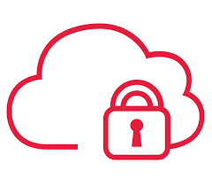
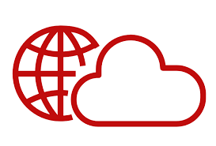
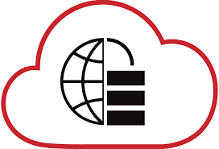
The Deployment Models of the Cloud
Private Cloud
Public Cloud
Hybrid Cloud
Cloud services used by a single organization, not exposed to the public.
Complete control
Security for sensitive applications
Meet specific business needs
Cloud resources owned and operated by a third- party cloud service provider delivered over the Internet.
serve multiple organizations (tenants) using the same shared infrastructure.
Keep some servers on premises and extendsome capabilities to the Cloud
Control over sensitive
assets in your private infrastructure
Flexibility and cost- effectiveness of the public cloud
Notes:
As we dive deeper into the world of cloud computing, it's pivotal to understand its various deployment models.
Starting with the Public Cloud, this is the most recognized form where resources are owned and operated by third-party providers, delivering them to users over the internet. Think of your major players like AWS or Google Cloud.
Then we have the Private Cloud, which is exclusive to a single entity. This model offers more control and security, often tailored to specific organizational needs.
Merging the best of both worlds, we have the Hybrid Cloud. It's all about flexibility, combining the strengths of both public and private clouds.

Slide 14
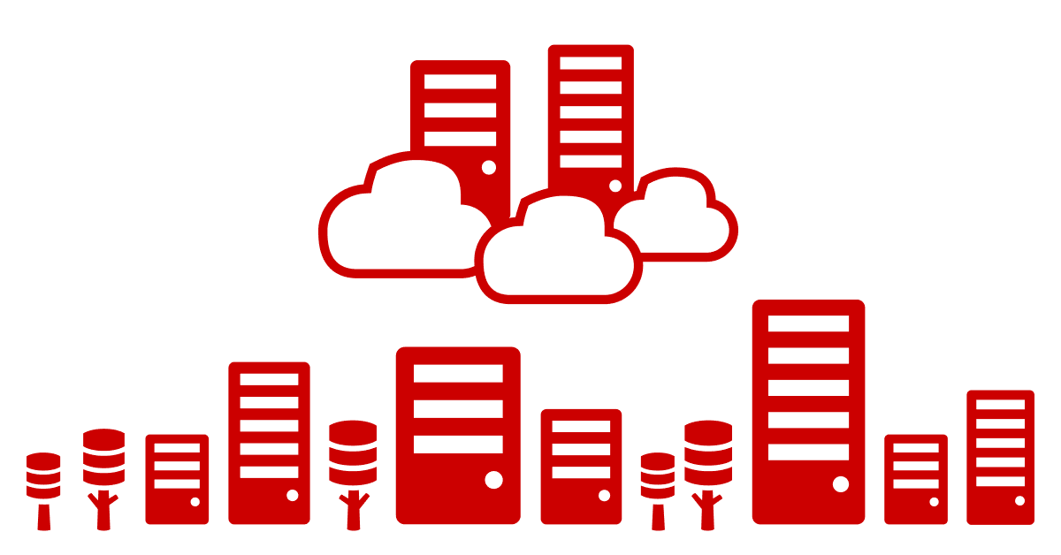
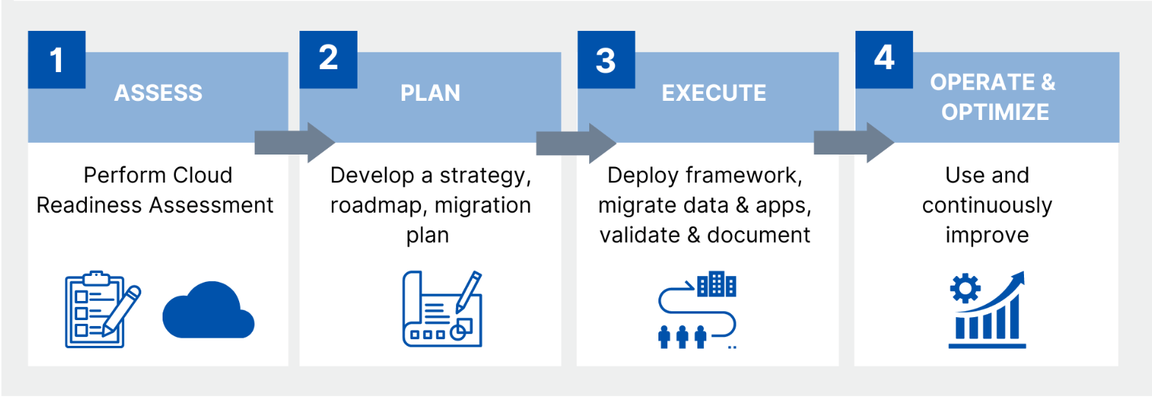
Cloud Migration Strategies
Notes:
Before getting started on any cloud migration journey, it’s important to know the “why”.
Understanding why you’re taking the cloud leap is imperative for a program to succeed and has consequences for design and implementation decisions, such as cost, treatment plans, timelines, roadmaps and team structures.
A cloud migration is the process of moving an organization’s digital assets, IT resources, services, databases, and applications from an on-premises legacy infrastructure to a public cloud hyperscaler such as AWS, GCP, or Azure environment. It involves more than just moving your data; it’s moving your data and analytics workloads as well.
The process can be broadly categorized into four phases.
First, we have 'Assessment.' This is all about understanding your current IT infrastructure, identifying which applications and data can be moved to the cloud, and determining what might need to be modified or replaced. It’s a critical stage to ensure that you’re fully prepared for the next steps.
Next, comes the 'Planning' phase. Here, you create a comprehensive migration plan, detailing the resources required, estimating costs, and setting a realistic timeline. It’s like charting the course for your cloud journey.
Then, we move on to the actual 'Migration.' This is where the action happens. You execute the plan, transitioning your data, applications, and workloads to the cloud environment. It’s a delicate phase, requiring precision and careful monitoring to ensure everything goes smoothly.
Finally, we reach the 'Optimization' stage. Post-migration, it’s time to fine-tune your resources, ensuring they are performing efficiently and cost-effectively. This is also when you establish best practices for ongoing cloud management, setting the stage for long-term success.

Slide 15
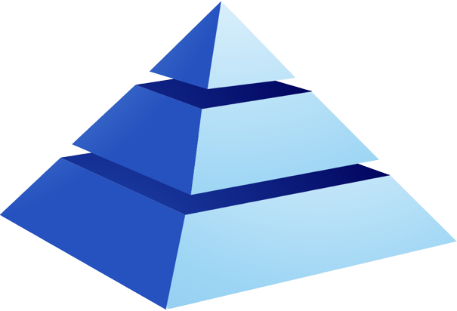
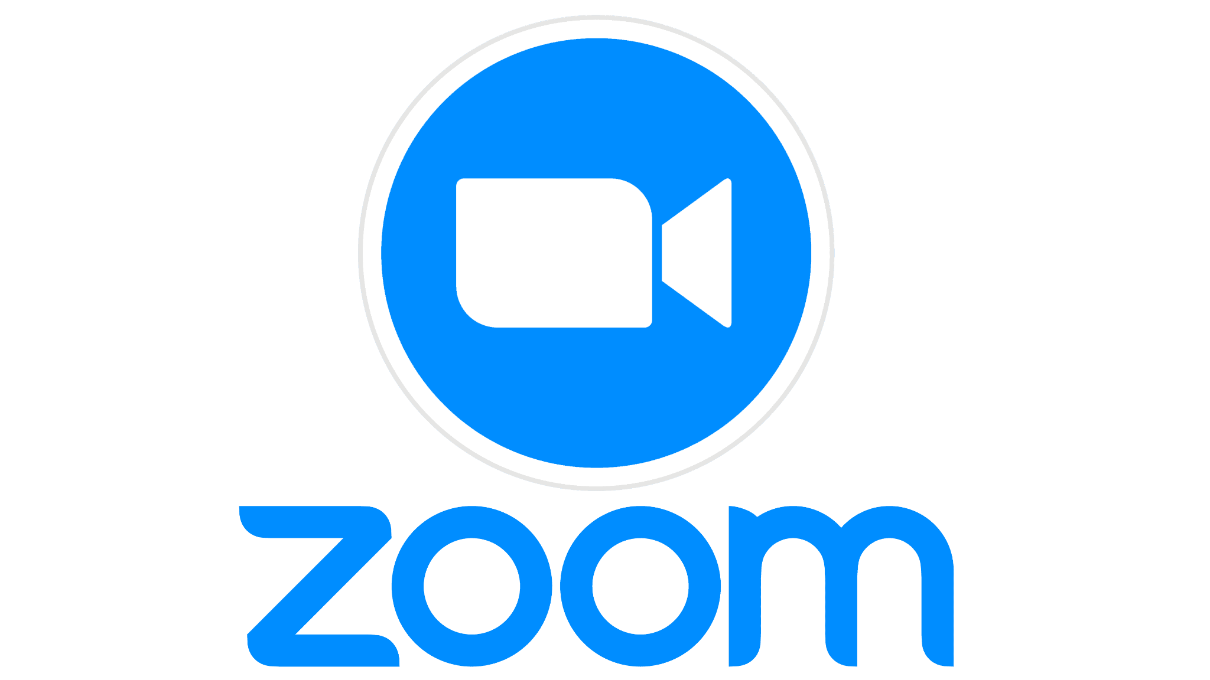
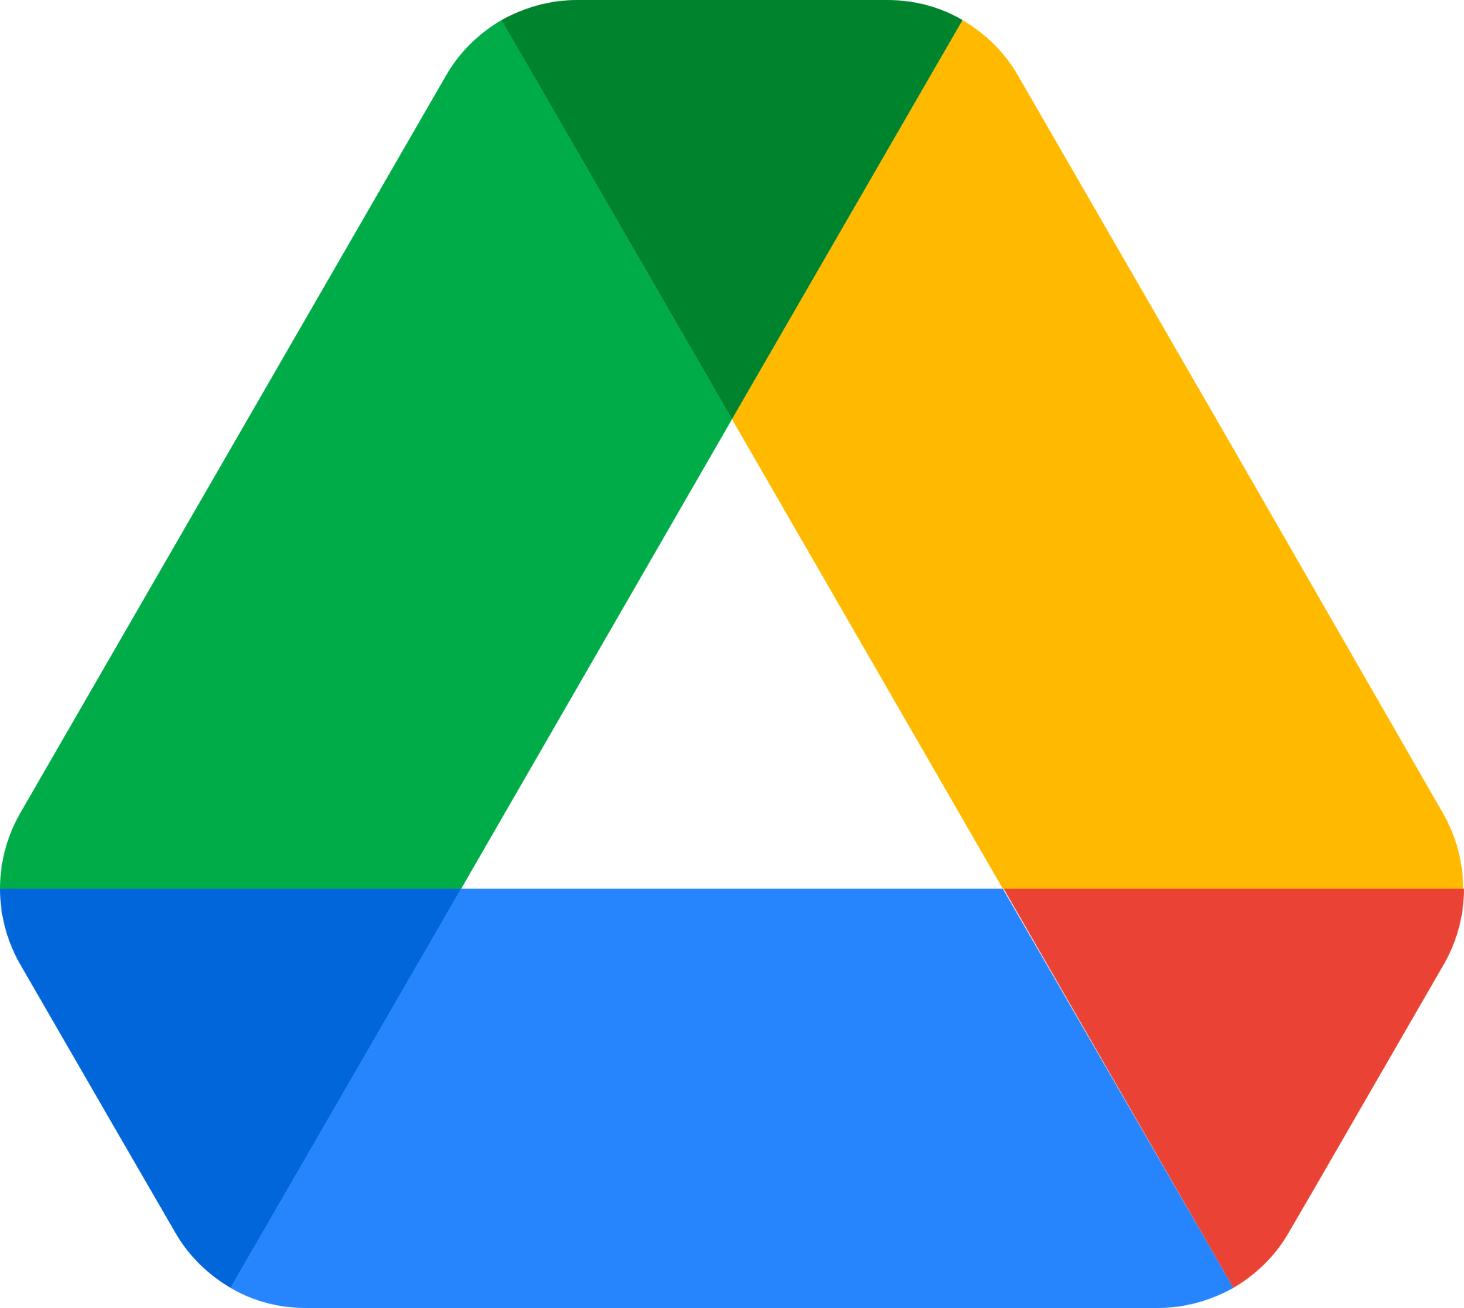

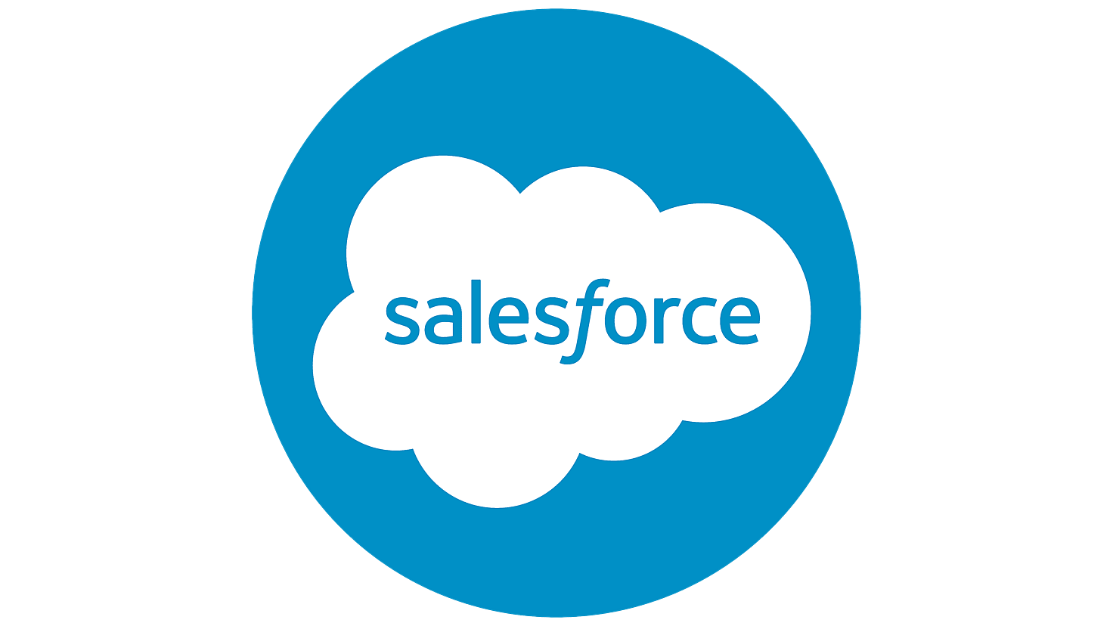

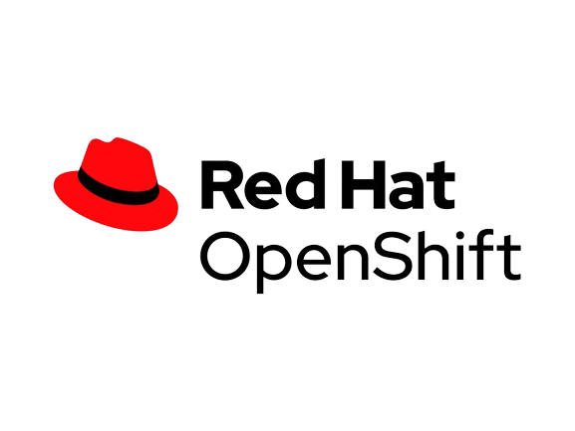
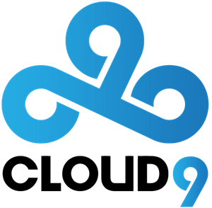
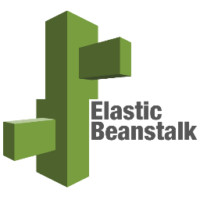
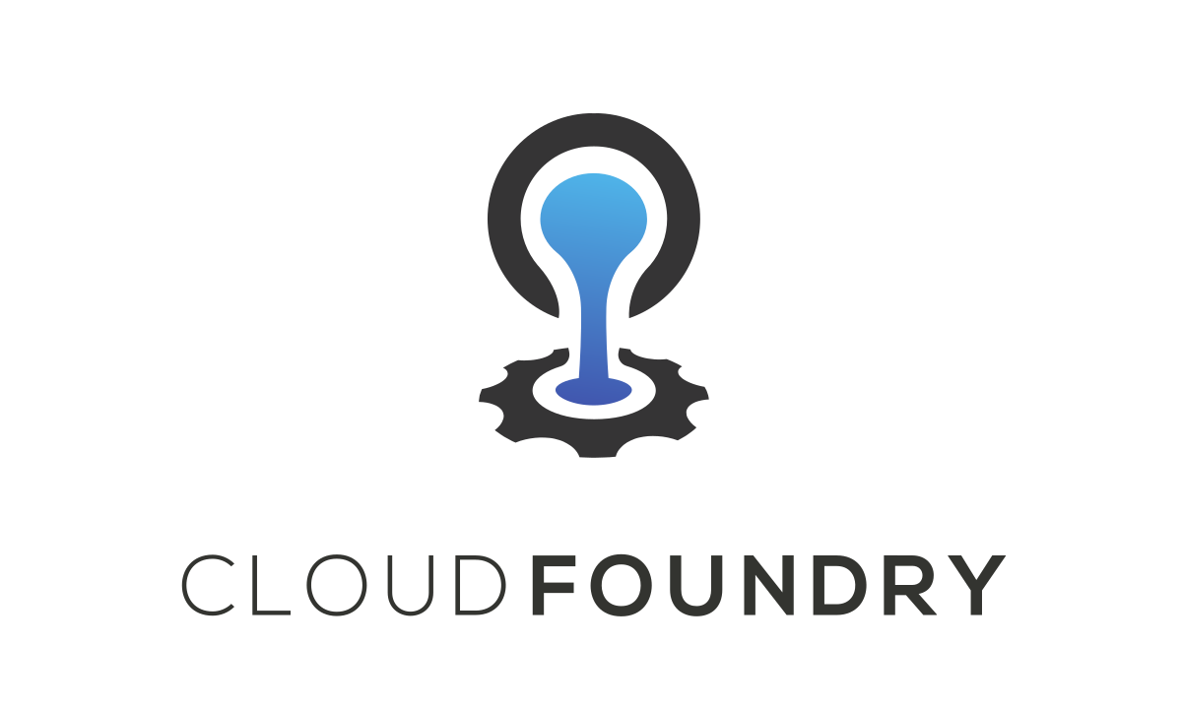
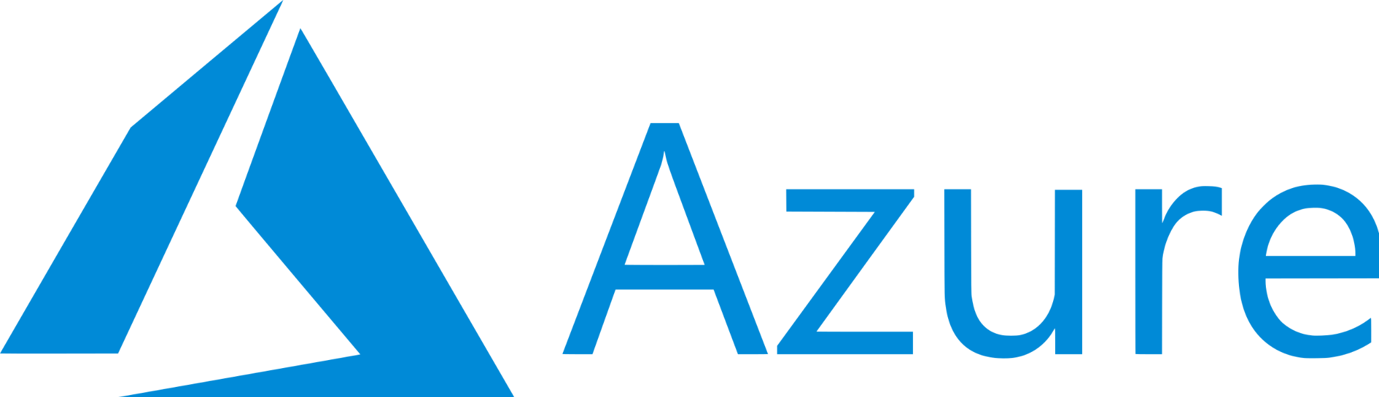
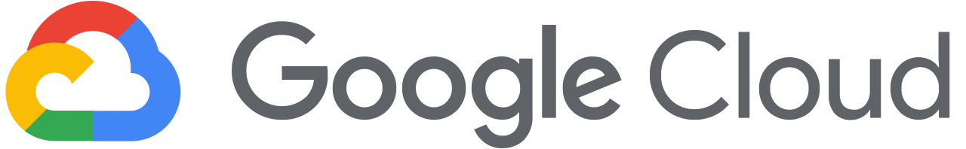
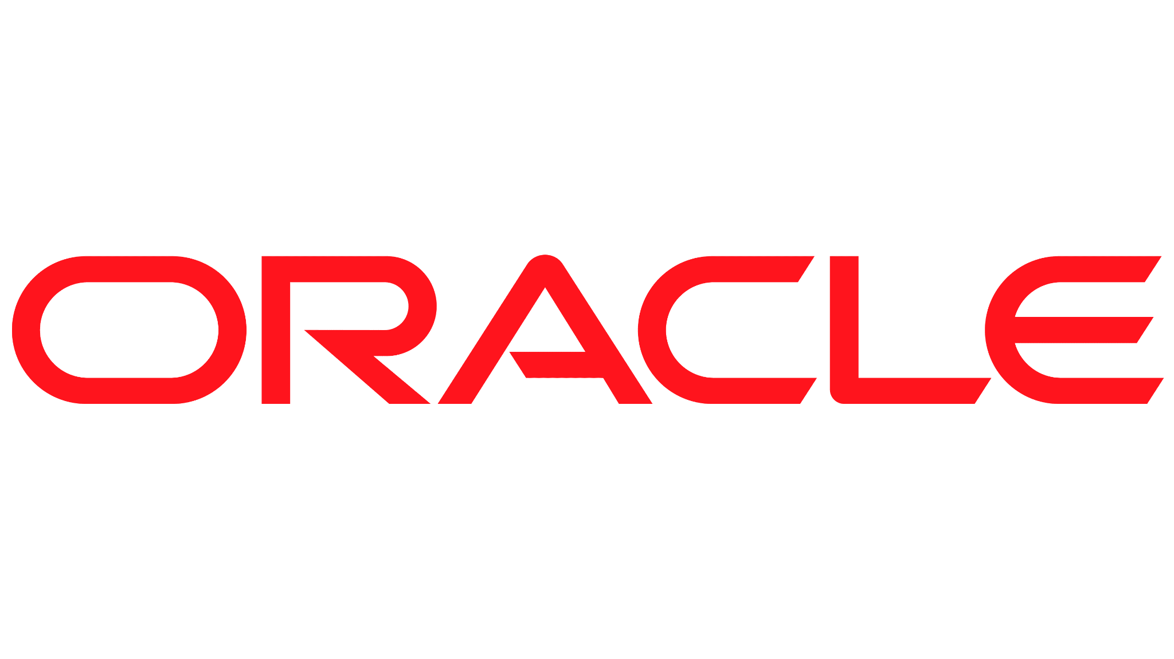
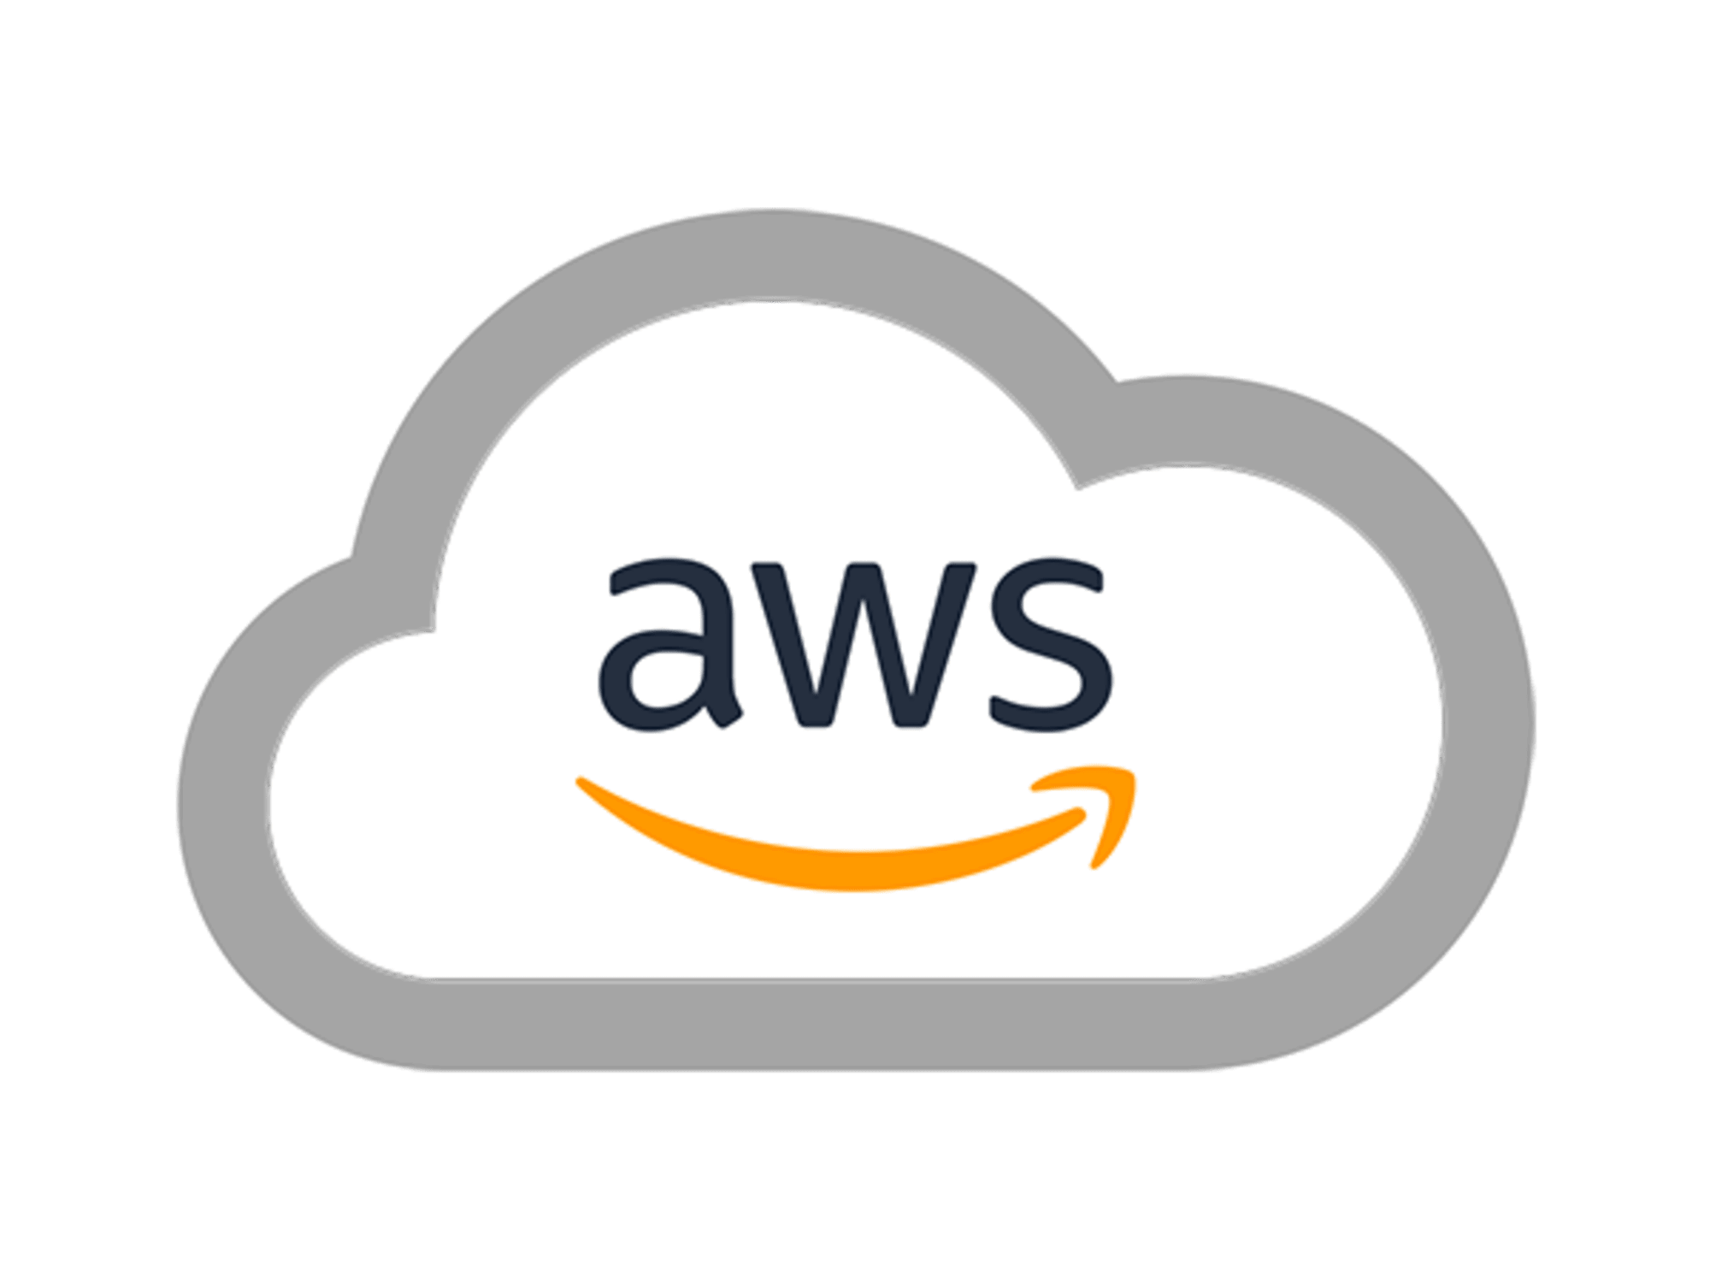
Types of Cloud Computing
less
End users
SAAS
control
Software developers
PAAS
more
IT administrators
IAAS
Notes:
visualized here as a pyramid representing its core service models. and cloud computing types.
it’s crucial to understand the nuances of each service model and how they collectively shape the way we leverage cloud resources.
Starting at the base, we have Infrastructure as a Service (IaaS), This layer provides the essential building blocks for cloud IT, encompassing networking, computers, and data storage space. It offers the highest level of flexibility and draws a direct parallel with traditional on-premises IT, making it a familiar ground for many organizations.
It’s the choice for those who want to manage and customize their infrastructure actively.
Ascending to the next level, Platform as a Service (PaaS) abstracts the complexity of infrastructure, providing a platform that enables developers to build, deploy, and manage applications with ease. Red hat openshift , the online editor cloud9 and AWS Elastic Beanstalk are prime examples.
PaaS streamlines the development process, sacrificing some level of control for increased simplicity and efficiency.
Reaching the summit, we arrive at Software as a Service, or SaaS. This is a completed product, run and managed entirely by the service provider. It represents the pinnacle of simplicity and convenience, offering ready-to-use applications directly over the internet. think gmail , drive , zoom platform
Please observe the arrow alongside our pyramid, symbolizing the trade-off between control and simplicity as we move upward. At the bottom, control is at its maximum, but as we ascend, control decreases while simplicity and ease of use increase. This visual guide assists us in choosing the right cloud service model based on our specific needs for control and convenience.

Slide 16
Infrastructure
as a Service
Platform as a
Service
Software as a
Service
On Premises
Application
Application
Application
Application
Data
Data
Data
Data
Runtime
Runtime
Runtime
Runtime
Middleware
Middleware
Middleware
Middleware
O/S
O/S
O/S
O/S
Virtualization
Virtualization
Virtualization
Virtualization
Server
Server
Server
Server
Storage
Storage
Storage
Storage
Managed by the provider
Networking
Networking
Networking
Networking
Managed by Customer
Notes:
Starting with On Premises, this is the traditional model where everything is managed in-house. From applications to networking, every component is under our control. While this provides us with maximum control, it also implies maximum responsibility for maintenance, updates, and security.
In traditional on-premises environments, you figure out how much capacity you need, purchase the hardware, wait for it, set it up, and access the resources over your network.
The challenge with an on-premises environment is if there is not enough capacity, you must purchase more and wait for the servers to be delivered to your site. Another challenge is if you have too much capacity, you are left with an over-provisioned environment.
Moving to the cloud, we have Infrastructure as a Service. In this model, we manage the application, data, runtime, middleware, and the operating system. Everything below that, including virtualization, servers, storage, and networking, is managed by the cloud provider. This model offers us flexibility and scalability while reducing the burden of managing physical hardware.
Next up is Platform as a Service. Here, we focus solely on managing our applications and data. The cloud provider takes care of the rest, offering a platform allowing us to develop, run, and manage applications without the complexity of building and maintaining the underlying infrastructure.
Lastly, we have Software as a Service. This is the most comprehensive cloud offering where everything is managed by the provider. We simply use the software through a web browser, with the provider taking care of maintenance, updates, and security. This model is perfect for applications that require minimal customization and are more standardized.

Slide 17
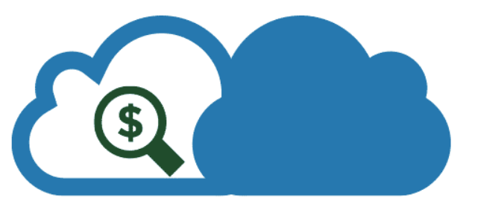
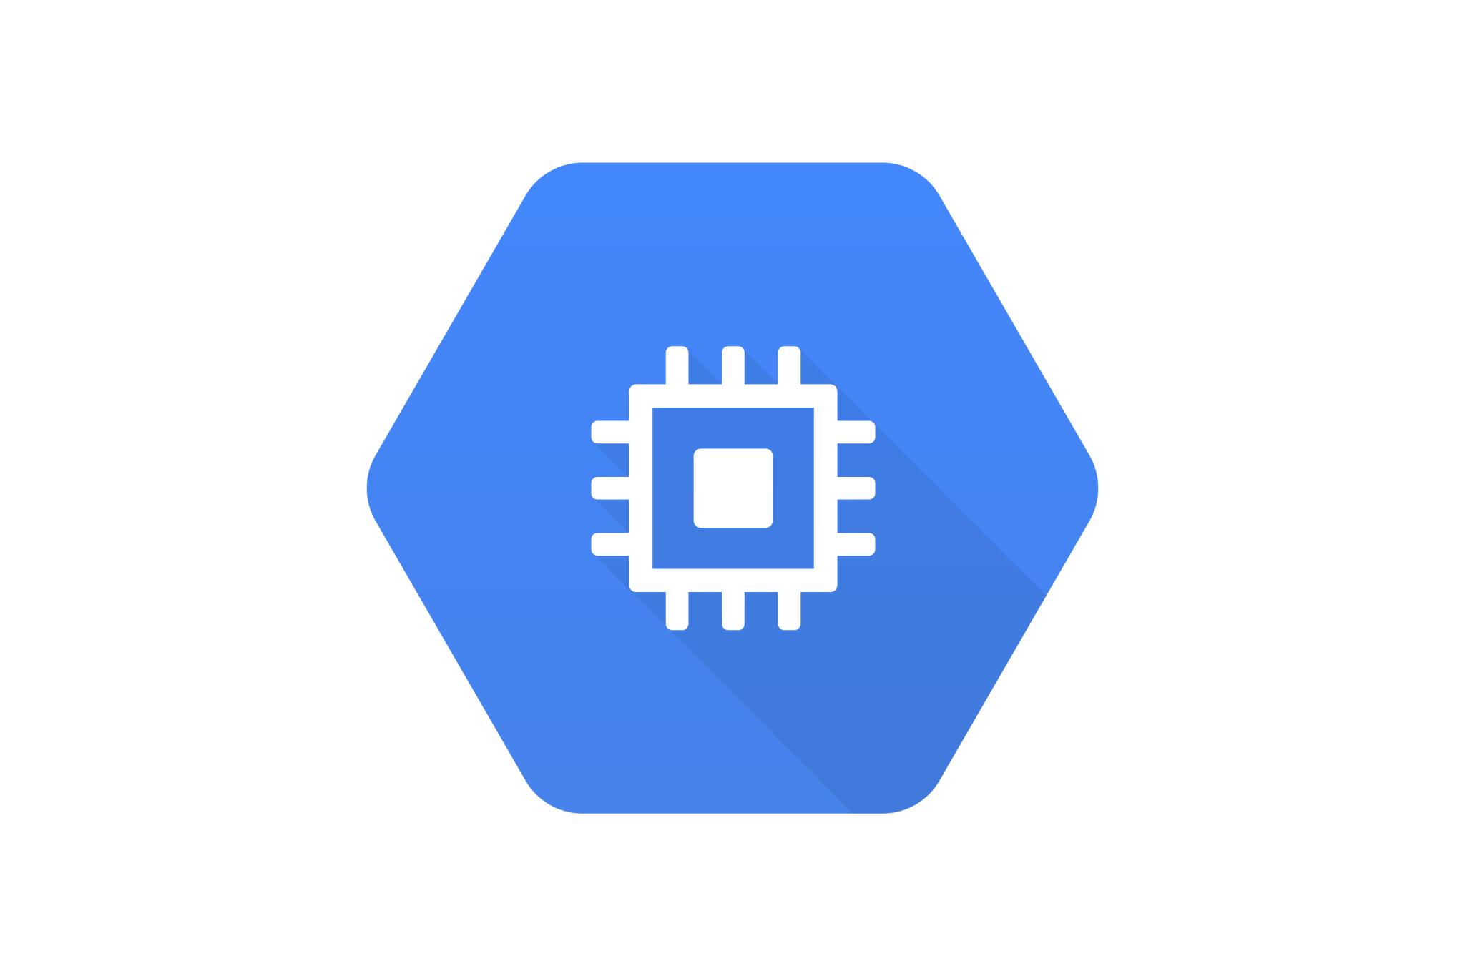
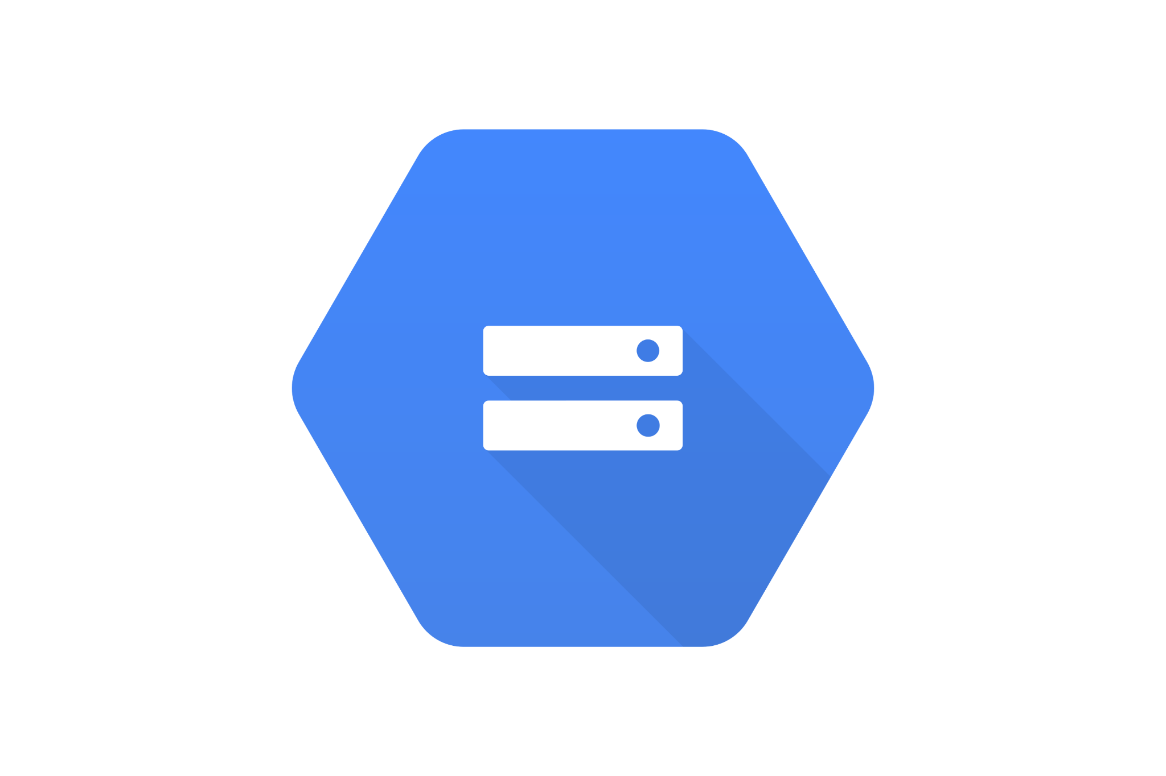
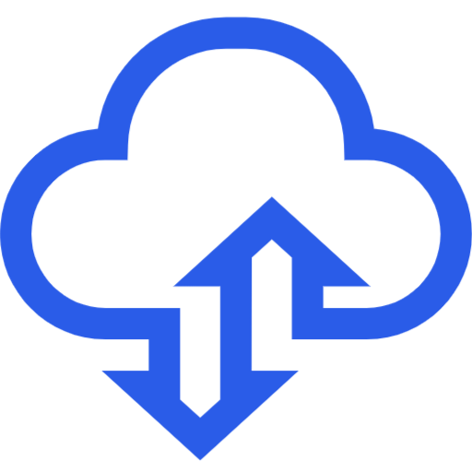
Pricing of the Cloud – Quick Overview
Compute : Pay for compute time
Storage : Pay for data stored in the Cloud
Data transfer OUT of the Cloud : Data transfer IN is free
Notes:
Cloud pricing, exemplified by Amazon Web Services (AWS), is characterized by simplicity and flexibility, following a pay-as-you-go model. AWS pricing fundamentals include paying for compute time, data storage, and data transfer out of the Cloud. Notably, data transfer into AWS is often free, solving a cost issue prevalent in traditional IT. This pricing approach aligns costs precisely with actual resource usage, enhancing cost-efficiency and providing organizations with a dynamic and cost-effective solution.

Slide 18
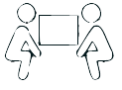
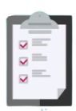


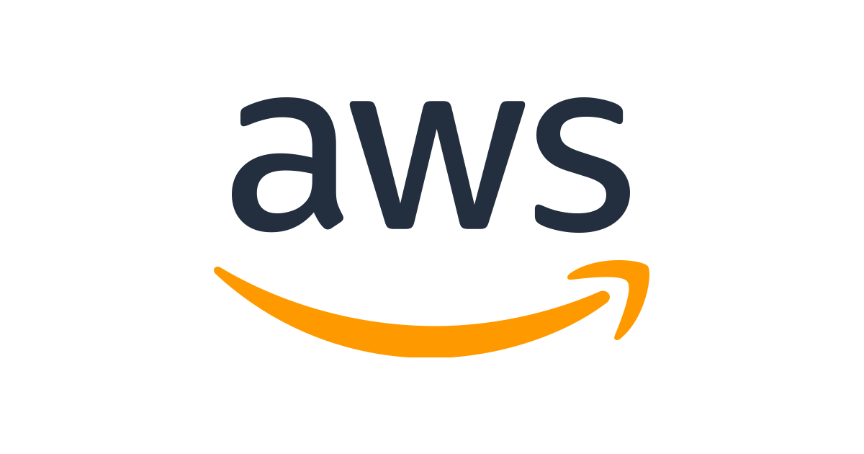
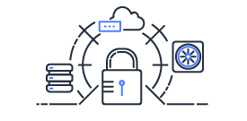
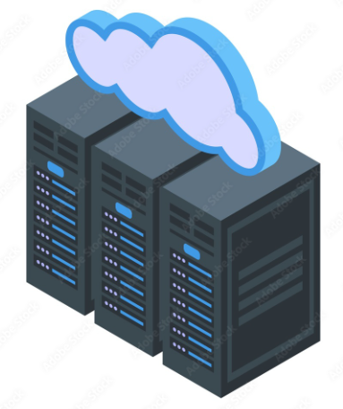
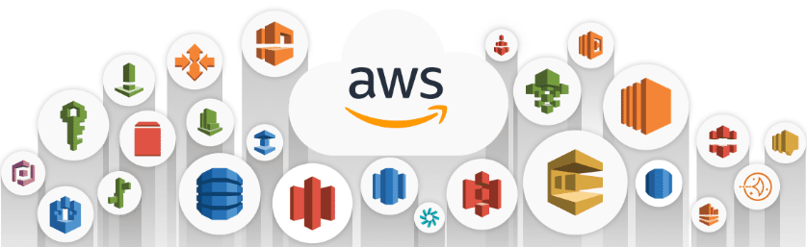
What is Shared Responsibility ?
AWS responsibility
Customer responsibility
Shared
between
+
+
manages
Guest OS
(updates & patches )
Aws security
Compliance
Customer
Customer
Application software
Host OS layer
Security Group
deploys
Data encryption
responsible for chosen services
Virtualization Layer
Classifying assets
protects
Physical security at AWS facilities
users permissions
composed of
Hardware
Software
Networking
Notes:
When you work with the AWS Cloud, managing security and compliance is a shared responsibility between AWS and you. To depict this shared responsibility, AWS created the shared responsibility model. The distinction of responsibility is commonly referred to as security of the cloud as compared to security in the cloud.
In the cloud, security is a shared responsibility. What this means is that the responsibilities for security are divided between the cloud service provider and the customer. It's a partnership where each party has distinct roles to play in safeguarding data and systems
The customers' level of responsibility depends on the AWS service. Some services require the customer to perform all the necessary security configuration and management tasks. Other more abstracted services require customers to only manage the data and control access to their resources. Using the two categories of AWS services, customers can determine their level of responsibility for each AWS service that they use.
AWS is responsible for security of the cloud. This means that AWS protects and secures the infrastructure that runs the services offered in the AWS Cloud. AWS is responsible for the following:
Protecting and securing AWS Regions, Availability Zones, and data centers, down to the physical security of the buildings
Managing the hardware, software, and networking components that run AWS services, such as the physical servers, host operating systems, virtualization layers, and AWS networking components
A key concept is that customers maintain complete control of their data and are responsible for managing the security related to their content. For example, you are responsible for the following:
Choosing a Region for AWS resources in accordance with data sovereignty regulations
Implementing data-protection mechanisms, such as encryption and scheduled backups
Using access control to limit who can access your data and AWS resources
properly choose and configure the service and their applications,

Slide 19
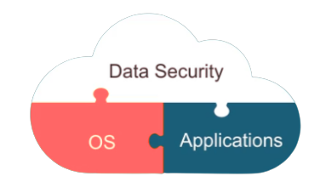
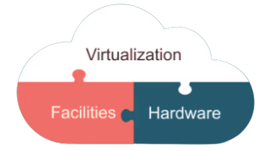
Shared Responsibility Model diagram
Customer data
Platform , application , identity & access management
CUSTOMER = RESPONSIBILITY FOR
THE SECURITY IN THE CLOUD
Operating system , network & firewall configuration
Client side encryption
Server side encryption
traffic protection
Software
Compute
Storage
Database
Networking
Hardware / AWS global infrastructure
Provider = RESPONSIBILITY FOR
THE SECURITY OF THE CLOUD
Regions
Availability zones
Edge locations
Notes:
This model is crucial to understand as it defines the responsibilities of both cloud service providers and customers when it comes to securing data and applications in the cloud.
Cloud Service Provider Responsibilities
First, let's look at the cloud service provider's responsibilities. They are responsible for the security of the cloud infrastructure itself. And when I say global infrastructure, I mean the physical infrastructure that the cloud is running on. This is iron and concrete buildings with fences protected by security guards and various other security measures. It also includes the AWS global backbone or the private fiber cables that connect each AWS Region to each other. Managing the security of these pieces is all in AWS. You don't need to worry about that as far as security goes. Then there is the infrastructure and various software components that run AWS services. This includes compute databases, storage, and networking. AWS is responsible for securing these services from the host operating system up through the virtualization layer.
Customer Responsibilities
So, if AWS manages the underlying hardware up through the virtualization layer, then what are you responsible for? Well, you are responsible for security in the cloud. Similar to how a construction company builds a building, and it's on them to make sure that the building itself is stable and secure, then you can rent out an apartment in that building. It's up to you to lock the door to your apartment. Security of the building and security in the building are two different elements. For security in the cloud, the base layer is secured by AWS. It's up to you to lock the door. So, for our EC2 example, you are responsible for tasks like patching the operating systems of your VMs, encrypting data in transit and at rest, configuring firewalls, and controlling who has access to these resources and how much access they have. The main thing to understand is that you own your data in AWS. You are ultimately responsible for ensuring that your data is encrypted, secure, and has proper access controls in place.
So, that's the shared responsibility model at a high level. I do want you to keep something in mind, though. There is some amount of nuance you should understand as we move through the course regarding the shared responsibility model. Each AWS service is different and serves a different purpose and a different use case. Therefore, the shared responsibility model can vary from service to service as well

Slide 20
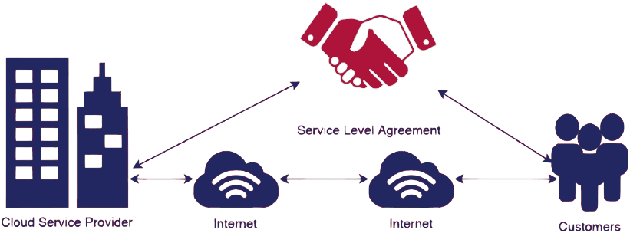
Service Level Agreements (SLAs)
Notes:
After establishing the foundation of the shared responsibility model, let's move on to explore how these responsibilities are translated into concrete commitments using Service Level Agreements.
Service Level Agreements (SLAs) are essential contracts in cloud computing that define the quality and availability of services offered by cloud providers. These agreements encompass critical components like uptime guarantees, performance metrics, data security, support levels, and maintenance schedules. SLAs come in various forms depending on the cloud service model (IaaS, PaaS, or SaaS) and can often be negotiated to align with specific business needs. Effective SLA management involves continuous monitoring of performance metrics, with real-world case studies serving as valuable illustrations of both successes and challenges. Adhering to best practices in SLA management ensures that cloud services meet and exceed the expectations of customers while fostering trust and accountability in the cloud ecosystem.

Slide 21
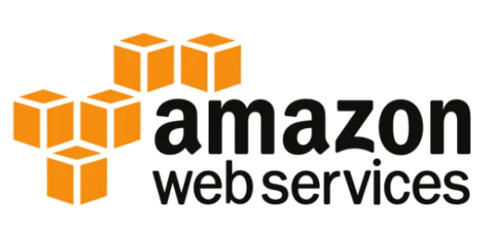
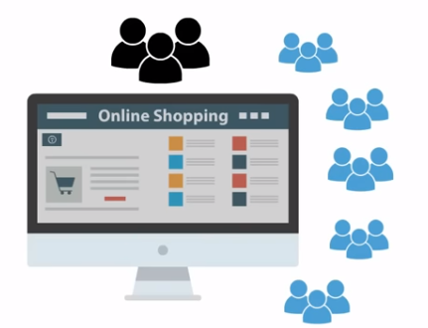


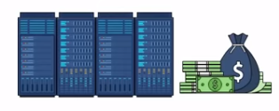

Amazon's Foray into Cloud Computing
Amazon's Early Days: A Web Giant's Growing Pains
Amazon, originally launched as an online bookstore, quickly expanded its offerings and became the go-to platform for online shopping.
Notes:
As Amazon grew, so did its website's complexity and traffic, leading to a need for robust IT infrastructure.
The company invested heavily in servers to handle peak loads, especially during holiday shopping seasons like Black Friday.
Outside of peak periods, a significant portion of Amazon's computing resources remained unused.
But with these challenges came an opportunity.

Slide 22
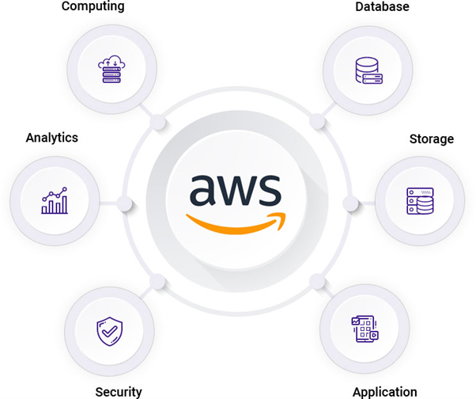
The Birth of AWS
From Online Bookstore to Cloud Pioneer
Amazon launched AWS in 2002, initially as a way to provide developers with tools and access to Amazon's internal infrastructure.
Industry Catalyst: AWS democratized infrastructure, fueling a new wave of innovation across the tech landscape.
Notes:
The realization hit: the infrastructure, which was scalable for Amazon, could also serve the needs of other businesses and developers.
Beyond just renting out unused capacity, AWS's vision grew. They aimed to provide a comprehensive suite of tools and services that would enable businesses to offload their IT infrastructure, making it easier and more cost-effective to scale and innovate.

Slide 23
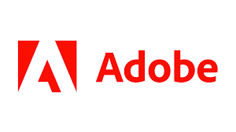


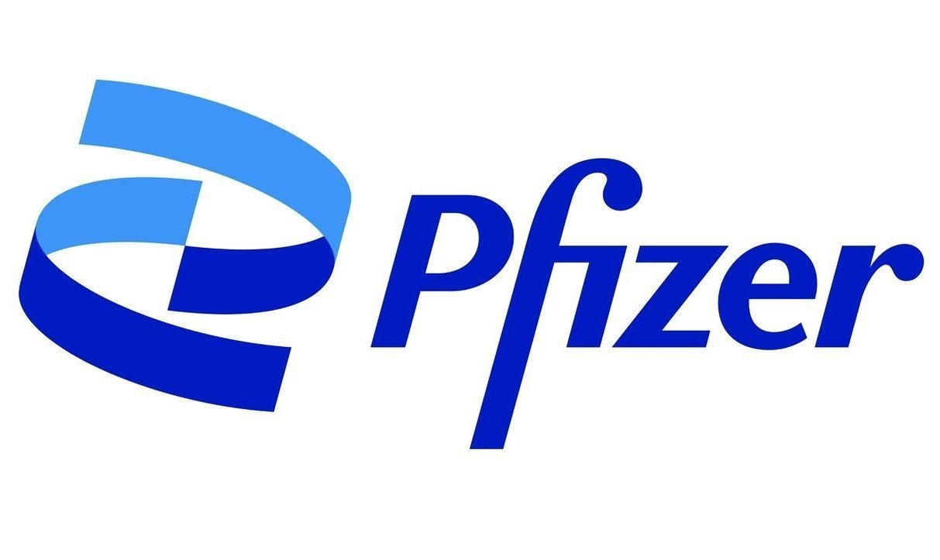



Leading Companies Powered by AWS

Slide 24
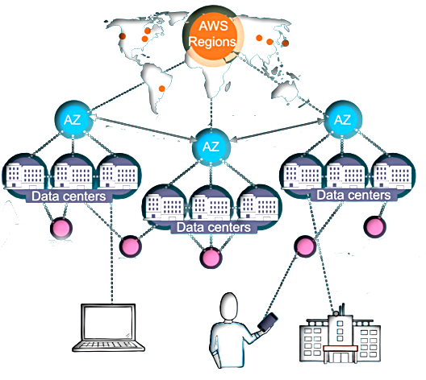

AWS Global infrastructure components
AWS regions
Data centers
Separate geographic areas
Each availability zone (AZ) is one or more , typically 3,
discrete data centers with redundant power,
networking, and connectivity
Fully isolated
Many KMS
Availability zones
Point of presence
POP
POP
AWS regions :
A region is a cluster of data centers
Each region has many availability zones
(usually 3, min is 3, max is 6)
POP
POP
Edge Locations
Regional edge cache servers
Amazon has 550+ Points of Presence in 90+ cities across 40+ countries
POP
Notes:
AWS has clusters of data centers around the world. So here AWS would have a second data center connected to the first through redundant high speed and low latency links. That way, if the first data center goes down, the second data center is still up and running. This cluster of data centers is called an Availability Zone, or AZ. An AZ consists of one or more data centers with redundant power, networking, and connectivity. Unfortunately, sometimes natural disasters like hurricanes or other disasters might also extend to impacting an entire AZ, but AWS has planned for that,, using redundancy. Like data centers, AWS also clusters AZs together and also connects them with redundant high speed and low latency links. A cluster of AZs is simply called a Region.
• Edge Locations (Points of Presence): Edge locations and regional edge caches are used to cache content closer to end users, thus reducing latency.
For example, if your media content is in London and you want to share video files with your customers in Sydney, you could have the videos cached in an edge location closest to Sydney. This would make it possible for your customers to access the cached videos more quickly than accessing them from London. Currently, there are over 400+ edge locations globally.

Slide 25

AWS Global infrastructure components
32 Launched Regions
each with multiple Availability Zones (AZs)
102 Availability Zones
550+ Points of Presence
and 13 Regional Edge Caches
Notes:
The AWS Cloud spans 102 Availability Zones within 32 geographic regions around the world, with announced plans for 15 more Availability Zones and 5 more AWS Regions in Canada, Germany, Malaysia, New Zealand, and Thailand.
Inside every Region is a cluster of Availability Zones. An Availability Zone consists of one or more data centers with redundant power, networking, and connectivity. These data centers operate in discrete facilities in undisclosed locations. They are connected using redundant high-speed and low-latency links.
Availability Zones have code names. Because they are located inside Regions, they can be addressed by appending a letter to the end of the Region code name. Here are examples of Availability Zone codes:
eu-east-1a is an Availability Zone in eu-east-1 (Ireland Region).
Therefore, if you see that a resource exists in eu-east-1c, you can infer that the resource is located in Availability Zone c of the eu-east-1 Region.

Slide 26
Choosing the right AWS Region
Latency | Pricing | Service availability | Data compliance
For applications sensitive to latency, pick a Region near your users to reduce wait times. High latency notably affects synchronous tasks like gaming and IoT, and can also impact asynchronous tasks like ecommerce. | Prices for operating data centers vary across Regions due to factors like internet connectivity, equipment costs, and local economy. Instead of a global flat rate, AWS charges based on each Region's specific financial considerations. | Some services might not be available in some Regions. The AWS documentation provides a table that shows the services available in each Region. | Enterprise companies often must comply with regulations that require customer data to be stored in a specific geographic territory. If applicable, choose a Region that meets your compliance requirements.
Notes:
AWS Regions are independent from one another. Without explicit customer consent and authorization, data is not replicated from one Region to another. When you decide which AWS Region to host your applications and workloads, consider four main aspects: latency, price, service availability, and compliance.

Slide 27


Edge locations
Notes:
Amazon CloudFront delivers your content through a worldwide network of edge locations. When a user requests content that is being served with CloudFront, the request is routed to the location that provides the lowest latency. So that content is delivered with the best possible performance. CloudFront speeds up the distribution of your content by routing each user request through the AWS backbone network to the edge location that can best serve your content.

Slide 28
















AWS Well-Architected Pillars
Operational excellence
Security
Reliability
Monitor
Improve
24/7 oversight
Data protection
Ensure
workload
Recover
Performance efficiency
Cost optimization
Sustainability
Select
Understand
Control
Minimize
impact
Types
Sizes
Performance
Efficiency
Energy consumption
Resource use
Reduce the downstream impact
Resources
Trends
Spending
Notes:
Operational Excellence: It's all about ensuring our systems run smoothly and evolve as the business demands. Think of it like maintaining a well-oiled machine, where every operation can be coded, changes are small and reversible, and learning is continuous.
Security: This is the bedrock of cloud services. AWS emphasizes strong identity management, ensuring traceability, and securing every layer of our infrastructure. Remember, in the cloud world, security is everyone's job!
Reliability: Imagine if Netflix went down during your favorite show? Not a pleasant thought, right? This is where reliability comes in. It's about designing systems that can bounce back from issues, scale as needed, and avoid those 'Oh no!' moments.
Performance Efficiency: In the cloud, efficiency is the name of the game. We want to leverage the best technologies, deploy globally in minutes, and ensure our systems remain agile as they grow.
Cost Optimization: No one likes wasting money. AWS helps us ensure we're only paying for what we use, understanding our costs, and focusing on what matters most - delivering value!
Sustainability: As we move into an era where being 'green' is crucial, AWS ensures our workloads are environmentally friendly. By understanding our impact, setting goals, and maximizing utilization, we can make a positive difference.
Remember, these pillars are not about making trade-offs but about creating harmony. They're a synergy, helping us build robust, efficient, and sustainable systems in the cloud.

Slide 29



Interacting with AWS
AWS CLI
AWS management console
AWS SDK
Notes:
When I remove the ability for me to touch and see something, like when the infrastructure becomes virtual, the way that I work with that infrastructure has to change a bit. Instead of physically managing my infrastructure, now I logically manage it through the AWS Application Program Interface, or API. So now when I create, delete, or change any AWS resource, whether it's a virtual server or a storage system for employee photos, I use API calls to AWS to do that.
You can make these API calls in several ways, but the three main ways we're going to talk about in AWS are the AWS Management Console, the AWS Command Line Interface, and the AWS Software Development Kits, or SDKs. When people are first getting started with AWS, they typically use the AWS Management Console. This is a web-based method that you log into from your browser. The great thing about the console is that you can point and click. By simply clicking and following prompts, you can get started with some of these services without any previous knowledge of the service.
With the console, there's no need to worry about scripting or finding the proper syntax. When you log into the console, the landing page will show you services you've recently worked with but you can also choose to view all of the possible services organized into relevant categories such as compute, database storage, and more. If I change the Region to Paris, you're making requests to eu-west-3.console.aws.amazon.com or the Paris Region's web console. After you work with the console for a while, you may want to move away from the manual creation of resources. we will see in the upcoming sessions while introducing IAAC
The AWS CLI is a unified tool that you can use to manage AWS services. You can download and configure one tool that you can use to control multiple AWS services from the command line, and automate them with scripts. The AWS CLI is open source, and installers are available for Windows, Linux, and macOS.
AWS SDKs : API calls to AWS can also be performed by running code with programming languages. You can do this by using AWS SDKs. SDKs are open source and maintained by AWS for the most popular programming languages, such as C++, Go, Java, JavaScript, .NET, Node.js, PHP, Python, Ruby, Rust, and Swift.

Slide 30

Recap of Key Concepts
Definition and evolution of cloud computing : being able to use IT resources without owning them.
Model Versatility: Showcased the variety of cloud models and deployment options to suit diverse needs : Public, Private, Hybrid.
Security is Critical: Stressed the importance of security measures and awareness of potential threats.
Cloud advantages: cost savings, scalability, flexibility, work from anywhere.
Service models: IaaS, PaaS, SaaS.
Pricing of the Cloud : leverage the approach “ pay as go “.
Shared Responsibility between cloud providers and the customers.
Introduction to AWS and its global infrastructure : Acknowledged AWS's significant role and presence in the cloud industry.

Slide 31


Looking forward
Upcoming deep dive into AWS services
Hands-on AWS exploration.

